Slide 1
The Battle of the Neighborhoods
Presentation of Final Capstone Project
-
Project by Tobias Nover

Slide 2
Outline
Introduction
Data
Methodology
Results
Conclusion

Slide 3
Introduction
Toronto is a divers metropolis & a lot of different restaurants
Many people would like to have an overview where the best-rated restaurants of a specific category are located in town
This project describes where the best-rated Italian Restaurants are located

Slide 4
Data
The following data is used:
Toronto data that contains boroughs & neighborhoods along with their latitude & longitude
FourSquare data that contains venues close to a specific location
FourSquare data that contains information (e.g. rating) of a specific venue

Slide 5
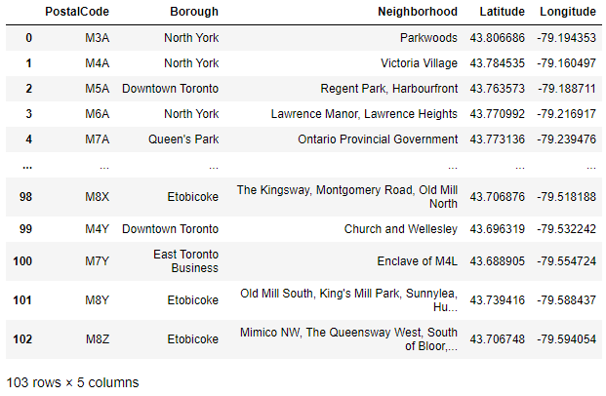
Methodology (I/III)
Scrape data from the Wikipedia-page of Toronto to get a dataframe with Postal Code, Borough & Neighborhood

Slide 6
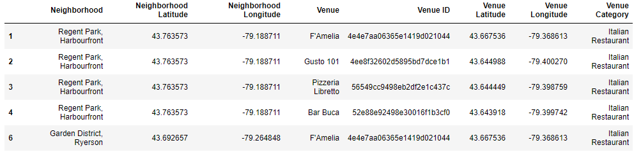
Methodology (II/III)
By using the FourSquare API get data about the top 5 venues of the category „Italian Restaurant“ in the vicinity of each neighborhood

Slide 7
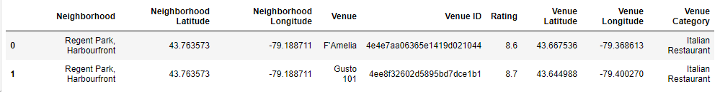
Methodology (III/III)
By using the FourSquare API get the rating of each of the venues

Slide 8
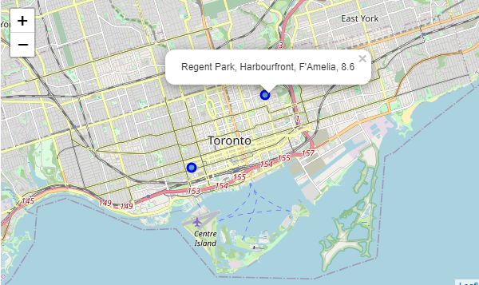
Results
As a result it is possible to see the locations of the venues in a map
Each marker shows the following descriptions:
Neighborhood, Venue-name, Venue-rating

Slide 9
Conclusion
Purpose was to give a good overview about the best-rated Italian restaurants in Toronto
Result is a good visual map where the restaurants are located
Limitation: Only possible to show limited amount of venues because of limitations of the FourSquare API as it is only possible to get a limited amount of ratings per day with the free account

